Slide 1
Dictionary size
1
[0, 1, 0, 0, 0, 0, 0, 0,...]
7
One Hot Encoding
[0, 0, 0, 0, 0, 0, 0, 1,...]
0
Input length
[1, 0, 0, 0, 0, 0, 0, 0,...]
Input length
3
[0, 0, 0, 1, 0, 0, 0, 0,...]
5
[0, 0, 0, 0, 0, 1, 0, 0,...]
Symbol id

Slide 2
Embedding length
Symbol id：0
Vector 0
Symbol id：1
Vector 1
.
.
.
Dictionary size
Symbol id：d
Vector d

Slide 3
Embedding length
1
Vector 0
12
Vector 1
0
Input length
.
.
.
Dictionary size
d
5
Symbol id
Vector d

Slide 4
Embedding length
1
Vector 1
12
Word Embedding
Vector 12
0
Input length
Vector 0
Input length
d
Vector d
5
Vector 5
Symbol id

Slide 5
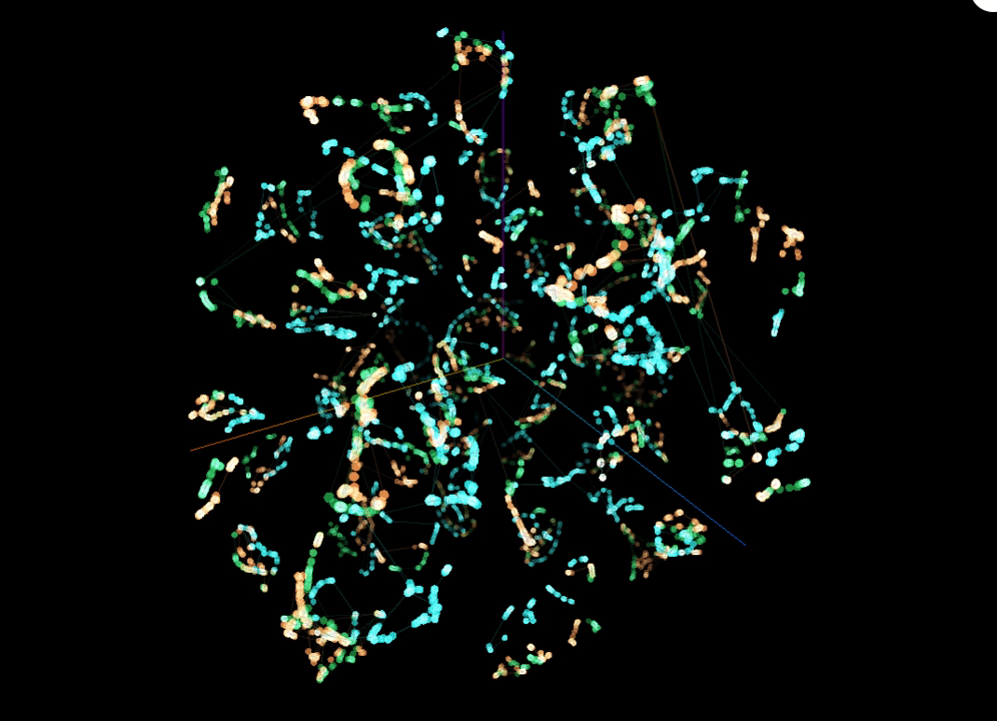

Slide 6
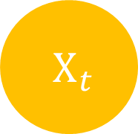


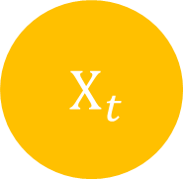
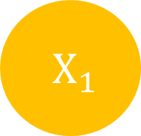
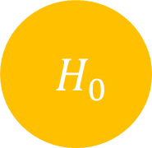
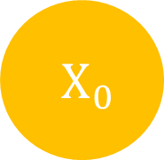

$H_{t}$
$H_{0}$
$H_{1}$
$H_{t}$
$X_{t}$
$X_{0}$
$X_{1}$
$X_{t}$

Slide 7
Input length
Input
Target length
Output
Target
Target length

Slide 8
Input
Output
Target
Target’
Target length
+1

Slide 9
Embedding length
Embedding length
Attention
注意力
is
就是
all
你
K length
Q length
you
所
need
需要
的

Slide 10
Output
Linear
& Sotfmax
Encoders
Decoders
Positional Encoding
Positional Encoding
Embedding
Embedding
Input
Target

Slide 11
Output
Linear
& Sotfmax
Encoders
Decoders
Positional Encoding
Positional Encoding
Embedding
Embedding
Input
Target

Slide 12
Output
Linear
& Sotfmax
Encoders
Decoders
Positional Encoding
Positional Encoding
Embedding
Embedding
Input
Target

Slide 13
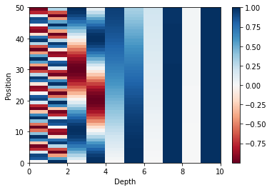
Position
Depth

Slide 14
Output
Linear
& Sotfmax
Encoders
Decoders
Positional Encoding
Positional Encoding
Embedding
Embedding
Input
Target

Slide 15
Encoder
Decoder
Encoder
Decoder
Encoder
Decoder

Slide 16
Encoder
Decoder
Encoder
Decoder
Encoder
Decoder

Slide 17
In
Out
LayerNorm
V
K
Q
Multi Head Attention
+
+
Feed Forward
LayerNorm

Slide 18
In
Out
LayerNorm
V
K
Q
Multi Head Attention
+
+
Feed Forward
LayerNorm

Slide 19
Out
Linear
Concat
Scaled Dot-Product Attention
Vin
Scaled Dot-Product Attention
Linear
V
Scaled Dot-Product Attention
Linear
V
Linear
V
Kin
Linear
K
Linear
K
Linear
K
Linear
Q
Qin
Linear
Q
Linear
Q

Slide 20
Embedding length
depth
Symbol length
Linear
Symbol length

Slide 21


K depth
K depth
Input length
Input length
$×$
$=$
Input length
Input length
Q
T
QK
K

Slide 22





Input length
Input length
Input length
Input length
$$=$$
$$($$
$$)$$
$$Softmax$$
$\frac{ }{\sqrt{K depth} }$
Attention
Weight

Slide 23


Input length
V depth
V depth
Input length
$×$
$=$
Input length
Input length
Attention
Weight
V

Slide 24

Embedding length
Multi-Head Attention Output
Input length
V depth $×$ Head number
Input length
Linear

Slide 25
In
Out
LayerNorm
V
K
Q
Multi Head Attention
+
+
Feed Forward
LayerNorm

Slide 26
Encoder
Decoder
Encoder
Decoder
Encoder
Decoder

Slide 27
In
Out
LayerNorm
V
K
Q
Masked Multi Head Attention
+
Feed Forward
+
LayerNorm
LayerNorm
+
Q
Multi Head Attention
Encoder
K
V

Slide 28
In
Out
LayerNorm
V
K
Q
Masked Multi Head Attention
+
Feed Forward
+
LayerNorm
LayerNorm
+
Q
Multi Head Attention
Encoder
K
V

Slide 29
In
Out
LayerNorm
V
K
Q
Masked Multi Head Attention
+
Feed Forward
+
LayerNorm
LayerNorm
+
Q
Multi Head Attention
Encoder
K
V

Slide 30


-1e30
Target length
Target length
Target length
Target length
$+$
Target length
$=$
Target length
QK
Masking
QK
Masking

Slide 31
Target length
Target length
Target length
$$=$$
Target length
$$($$
$$)$$
$$Softmax$$
$\frac{ }{\sqrt{K depth} }$
Attention
Weight

Slide 32


K depth
K depth
Input length
Target length
$×$
Target length
$=$
Input length
Q
T
QK
K

Slide 33
Input length
Input length
Target length
Target length
$$=$$
$$($$
$$)$$
$$Softmax$$
$\frac{ }{\sqrt{K depth} }$
Attention
Weight

Slide 34


Input length
V depth
V depth
Target length
Input length
Target length
$×$
$=$
Attention
Weight
V

Slide 35
Embedding length
Multi-Head Attention Output
Target length
V depth $×$ Head number
Target length
Linear

Slide 36
Output
Linear
& Sotfmax
Encoders
Decoders
Positional Encoding
Positional Encoding
Embedding
Embedding
Input
Target

